Slide 1


SDP
LECTURE
The Command Pattern
Software Design Patterns
Diploma in IT
Year 2 (2024/25), Semester 4
7.2
Notes:
Hi everyone! The next design pattern we will be looking at is called the Command pattern, which takes encapsulation to a whole new level by encapsulating method invocation. Let’s see how it works by introducing another scenario.

Slide 2
Example Problem – Remote Control
Autohome Inc. has a programmable remote control for supported devices, such as lights and fans
7 slots, so it can support 7 devices
Each slot has an On and an Off button
There is also a global Undo button
Notes:
We are working for Autohome Inc., a company that sells a programmable remote control device that can control all kinds of other devices around the home, like lights, fans, ovens and so on. Their latest version has || 7 slots, which means that it can be programmed to handle 7 different devices. Each slot has || 2 buttons: an On button and an Off button, but as you will see later, these buttons can do pretty much anything you want it to do. Finally, it also has || a global Undo button that can undo the last action that was taken.

Slide 3
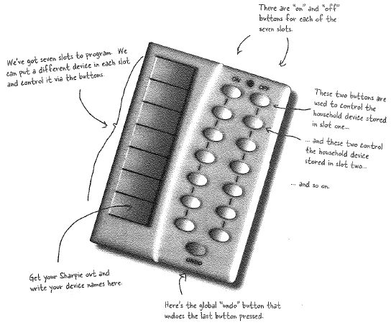
Example Problem – Remote Control
Image from Eric Freeman and Elisabeth Freeman, “Head First Design Patterns”, O’Reilly, 2004
Notes:
Let’s take a look at the actual hardware. Apologies for the low-resolution picture, I had to scan it from the physical copy of the textbook. Anyway, || here we see that there are 7 slots, and you can use a pen to write down which device each slot is controlling. Each slot consists of || 2 buttons which are labelled “on” and “off”. So || these two buttons are for slot 0, and || these two buttons are for slot 1. Finally, || right at the bottom there is an Undo button that will undo the action of the last button pressed. So the idea is that we could maybe program the first slot to control our living room light, the second slot to control our bedroom aircon, and so on. So using this one device, we can control up to 7 other devices.

Slide 4
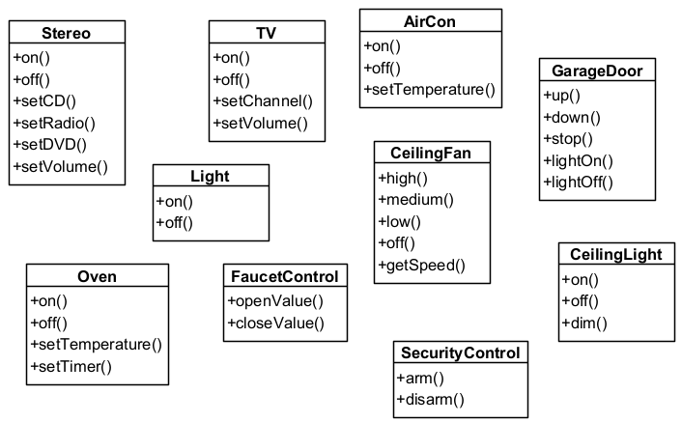
Vendor Classes
Diverse interfaces
and more…
Notes:
What devices can we control? Well, Autohome Inc. is working with lots of companies, and all these companies provide their own interfaces. So we might have lights with on() and off() methods, air cons with on(), off() and setTemperature() methods, and lots of other devices. Plus we expect to support lots more devices with other different interfaces in the future. Clearly, we need some clever way to code our system so that we can handle whatever new interface some future device will throw at us.

Slide 5





Intuition – Waitress Takes Order
1. Customer gives Waitress their Order
2. Waitress gives the Order to the Cook
3. Cook prepares meal based on Order
Notes:
OK, so how do we handle this? What we’re going to do is follow a process similar to what happens when a waitress takes a customer’s order in a restaurant. So we start with || a customer who wants to order some food. He || waves the waitress over, who takes his order. You can think of this as the customer creating the order and passing it to the waitress. Once this is done, the waitress will || take the order and pass it to the cook. Notice that the waitress does not need to know how to cook the order, she will leave the cooking of the meal to the cook. Upon receiving the order from the waitress, the cook will then || prepare the meal based on the order, producing the cholesterol-laden burger and fries ordered by the customer, and all is right with the world.

Slide 6
Roles and Responsibilities
Order
Request to prepare a meal
Has interface with one method, e.g., orderUp()
Waitress
Receives orders with takeOrder(Order) method
Calls orderUp()
Cook
Prepares the order
Notes:
This system works because each entity takes care of their own responsibilities, and they interact to produce the desired result. First, we have the || Order, which was created by the Customer. The Order is essentially a set of instructions to tell the cook what to do, such as “cheeseburger, extra onions, no mayo, diet coke and fries”. We can think of this set of instructions as if it is calling a || method called orderUp(). Next, we have the || Waitress who receives this Order object, and we can think of the Waitress as calling the method takeOrder() with the Order object as the input. Once this is done, she will || call the orderUp() method, which means that she passes the Order to || the Cook. Finally the Cook will receive the order and prepare the meal based on the instructions detailed in the Order.

Slide 7
From Diner to Command Pattern
orderUp()
public void execute() {
receiver.action1();
receiver.acition1();
}
execute()
create
Command
Object()
createCommandObject()
setCommand()
takeOrder()
Command
(Order)
Client
(Customer)
action1()
action2()
…
setCommand()
execute()
action1()
action2()
…
Invoker
(Waitress)
Receiver
(Cook)
Notes:
So that’s the overall plan. Now let’s see how the Command design pattern follows this plan. We start of with a || Client, which plays the role of the Customer in our analogy. This is the class that decides what commands to execute, and || creates a Command object containing these instructions, so the Command object is similar to an Order. The Command class has a single method called execute(), which are || the instructions to be followed, similar to the orderUp() method in our analogy. Specifically, these are a bunch of || method calls to some receiver class. Next, this order object is passed to another entity called the || Invoker, and the way this is done is by calling the Invoker’s setCommand() method, which is analogous to || the takeOrder() method. Finally, the Invoker will || call the execute() method of the Command, which is a || set of actions that another class called the Receiver will take. Of course, the Receiver is similar to the Cook in our analogy.
Back to our programmable remote control problem. The remote control is going to be our Invoker, and we will set different Command objects to its slots. Each device, like a light or a fan, will be a Receiver, and the commands will tell them what to do. And the client is just the program that sets up and uses the remote control. Sounds good? OK, let’s now take a look at the code.

Slide 8
Light Class
public class Light {
private string location;
public Light(string location) {
this.location = location;
}
public void on() {
Console.WriteLine($"{location} Light is ON.");
}
public void off() {
Console.WriteLine($"{location} Light is OFF.");
}
}
Notes:
We are going to start with one of the devices, which is a simple class representing a light. We have quite a few lights in the house, so we specify where the light is situated with a || location string, and we set this in the constructor. Other than that, this simple device only has two methods: an || on() method that turns the light on, and an || off() method that, surprise surprise, turns the light off. Very straightforward.

Slide 9
Command Interface
public interface Command {
public void execute();
}
public class LightOnCommand: Command
{
Light light;
public LightOnCommand(Light light) {
this.light = light;
}
public void execute() {
light.on();
}
}
Notes:
Next, let’s define our Command interface, which specifies one method called execute. Having specified this interface, we can now create a command that turns our light on, called the || LightOnCommand. This class controls a specific light, which we record in || this light attribute that we initialize in our constructor. Also, since LightOnCommand || implements the Command interface, it must implement the execute() method, which in this case just calls || light.on(). In the same way, we can create a LightOffCommand class that turns a light off.

Slide 10
A Simple Remote Control
public class SimpleRemoteControl
{
Command slot;
public SimpleRemoteControl() { }
public void setCommmand(Command command) {
slot = command;
}
public void buttonPressed() { slot.execute(); }
}
Notes:
Next, let’s create a simple remote control that only has one button, just to test our Command design pattern. This remote control only has || one programmable slot which will be executed when the button is pressed. In order to set a command to that slot, we will call the || setCommand() method. Finally, when we press the button, the || buttonPressed() method will be called, which will in turn call the execute() method of whatever command is put in our slot.

Slide 11
Let’s Test It
SimpleRemoteControl remote = new SimpleRemoteControl();
Light light = new Light(“Living Room”);
LightOnCommand lightOn = new LightOnCommand(light);
remote.setCommmand(lightOn);
remote.buttonPressed();
Living Room Light is ON.
Notes:
Right, let’s test this out. We first create our SimpleRemoteControl, Light and LightOnCommand objects. Next, we set the command for the button on our remote control to be the lightOnCommand object. Finally, we will || press the button by calling buttonPressed(). This calls slot.execute() and since slot is a LightOnCommand, it will call the LightOnCommand’s version of execute(), which || turns the light on. Voila, let there be light!

Slide 12
Another Command Object
public class SecurityArmCommand: Command
{
SecurityControl security;
public
SecurityArmCommand(SecurityControl security) {
this.security = security; }
public void execute() { security.arm(); }
}
Notes:
How about another device? What about a security system that you don’t turn on or off, but instead you would either arm or disarm it? No problem, we can create other Command objects to control the security system. The one shown here is the command to arm the security system, so its version of execute() will call || security.arm() instead.

Slide 13
Let’s Test It Again
SimpleRemoteControl remote = new SimpleRemoteControl();
Light light = new Light(“Living Room”);
LightOnCommand lightOn = new LightOnCommand(light);
SecurityControl secControl = new SecurityControl();
SecurityArmCommand secArm =
new SecurityArmCommand(secControl);
remote.setCommand(lightOn);
remote.buttonPressed();
remote.setCommand(securityArm);
remote.buttonPressed();
Living Room Light is ON.
Security system is ARMED.
Notes:
And we can use it in the same way as our light commands. In fact, we can even change what the slot does during run-time. We could initially set the slot to turn on the living room light, so the || light is turned on when we press the button. We can then re-program the slot to arm the security control, and now when we || push the button, the security system is armed instead. Pretty neat.

Slide 14
The Command Pattern
Notes:
So that is basically how the Command design pattern works. There’s actually a bit more to it, but let me first give you the formal definition before jumping into some of the finer details.

Slide 15
Definition
The Command Pattern:
Encapsulates a request as an object
Lets you parameterize clients with different requests
Supports undoable operations
Also known as
Action
Transaction
Notes:
The Command pattern takes a request, which is message asking an object to do something, and encapsulates it as a separate object. By doing so, you can now || pass these command objects into methods as parameters, and so you can set up different sets of requests during run-time. The Command pattern also || supports undoable operations, which we will look at later. This is also known as the || Action or the Transaction design pattern.

Slide 16
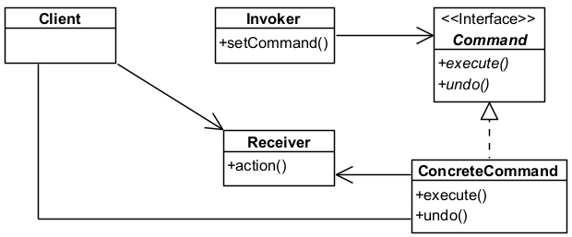
The Factory Method Pattern
Notes:
This is the class diagram for the Command pattern. We have an || interface called Command that specifies two methods execute() and undo(). We have || ConcreteCommands that implement the Command interface, so they will have their own versions of execute() and undo. Each ConcreteCommand refers to a || Receiver object that have their own set of methods that perform actions(), and the execute() method in the ConcreteCommand object calls these actions. The task of setting up all these commands is given to the || Invoker, which will organize all the ConcreteCommand objects in some logical way using its setCommand() method. Finally, the || Client is the class that creates all the Receiver objects and their corresponding ConcreteCommands.

Slide 17
Key Participants
Command
Declares an interface for executing an operation
ConcreteCommand
Defines a binding between a Receiver object and an action.
Implements execute() by invoking the corresponding operation(s) on the Receiver
Client
Creates a ConcreteCommand object and sets its receiver
Notes:
In summary, the Command pattern has 5 key participants. The || Command defines an interface for executing an operation, usually called execute(). It can also support additional operations such as undo(), and others if required.
The ConcreteCommand is a class that defines a binding between a Receiver object and an action. It’s like an order in a restaurant, which defines a binding between a Cook and all the dishes he can prepare. It does this by providing an implementation of the execute() method that calls the Receiver’s operations in the correct manner.
The Client is just the class that creates the ConcreteCommand objects and sets it to refer to the correct Receiver.

Slide 18
Key Participants
Invoker
Asks the Command to carry out the request by calling execute().
Receiver
Knows how to perform the operations associated with carrying out a request.
Any class may serve as a Receiver.
Notes:
The Invoker is the class that carries out the request by calling the execute method of the Commands, and it can be configured in various ways.
Finally, the || Receiver is the object that is controlled by the command. The Command object will call various methods of the Receiver to achieve its goal. Theoretically, any class may serve as a Receiver because any class can have its method calls encapsulated into a separate Command object.

Slide 19
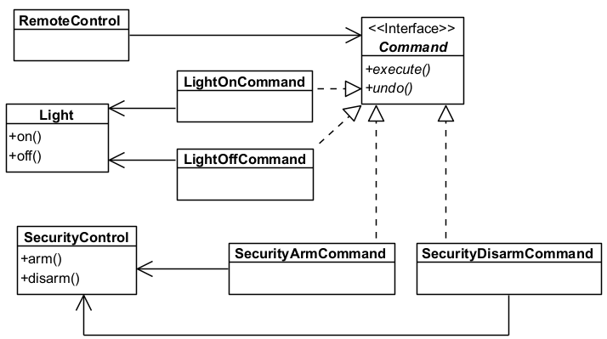
Applying Command to Remote Control
Invoker
Command
ConcreteCommand
Receiver
Receiver
ConcreteCommand
Notes:
Let’s see how we applied the Command pattern to our Simple Remote Control. Our || Command is literally an interface called Command, which defines the execute() method. And also the undo() method, which we will get to later, don’t be impatient. Next, we have the || LightOn and LightOffCommand objects, which are ConcreteCommands, that control our light, which is the Receiver. The LightOnCommand version of execute() will call light.on(), while the LightOffCommand version of execute() will call light.off(). We have a similar pairing of Receiver and its ConcreteCommands || with our SecurityControl. Finally, the RemoteControl class || is the Invoker. In our application, the Client is the main program that creates all these objects and sets everything up, although for other applications, the Client might be a separate class as well.

Slide 20
Implementing the Remote Control
public class RemoteControl {
Command[] onCommands;
Command[] offCommands;
public RemoteControl() {
onCommands = new Command[7];
offCommands = new Command[7];
Command noCommand = new NoCommand();
for (int i = 0; i < 7; i++) {
onCommands[i] = noCommand;
offCommands[i] = noCommand;
}
}
Notes:
So far, we have only created a simple remote control with one button. It’s now time to do the full-fledged remote control with 7 slots, each with an on and off button. Here’s our RemoteControl class. We are going to store the command objects in two arrays, || one for on commands and another for off commands. In our constructor, we first initialize them to size 7. Next, we are going to use a little trick by creating a || special type of Command object that we call noCommand. The NoCommand class implements the Command interface, but its implementation of the execute() method does nothing. This is an example of a null object. We will initialize all the slots in both arrays with this noCommand object. This will avoid cases where the program crashes if it tries to access a slot that has nothing assigned to it.

Slide 21
Implementing the Remote Control
public void setCommand(int slot,
Command onCommand, Command offCommand) {
onCommands[slot] = onCommand;
offCommands[slot] = offCommand;
}
public void onButtonPushed(int slot) {
onCommands[slot].execute();
}
public void offButtonPushed(int slot){
offCommands[slot].execute();
}
}
Notes:
Next, we will define the || setCommand() method that sets both the on and off command of a slot at the same time. This makes sense since each slot is supposed to control the same device with two buttons, one to turn it on and another to turn it off. For the given slot, the setCommand method will go to that index in the on and offCommand arrays and assign the provided commands to the respective slots. Finally, we now have separate methods for when an on button is pushed and when an off button is pushed. So the || onButtonPushed() method takes the slot index as its argument, and all it does is call the execute() method of the Command object in that slot in the onCommands array. Same thing with the offButtonPushed() method.

Slide 22
How About a Stereo?
public class Stereo {
private int volume;
public const int CD = 0;
public const int DVD = 1;
public const int RADIO = 2;
private int mode = CD;
public void on() {
Console.WriteLine("Stereo is ON.");
}
public void off() {
Console.WriteLine("Stereo is OFF.");
}
Notes:
You know what, let’s do something a bit more complex than a light or a security system. How about a stereo system? Here’s our fancy Stereo class that can play CDs, DVDs or transmit radio. To keep track of what kind of media it is playing, we will use some || constant integers to represent CD, DVD and RADIO, and have another attribute called || mode that stores the stereo’s current mode. Other than that, we have methods that perform all the functionalities of the stereo. We have on() and off() methods that turn the stereo on and off.

Slide 23
How About a Stereo?
public void setCD() {
mode = CD;
Console.WriteLine("Stereo Mode set to CD.");
}
// Similar code for setDVD() and setRadio()
public void setVolume(int volume) {
this.volume = volume;
Console.WriteLine(
$"Stereo volume set to {volume}.");
}
}
Notes:
We have a setCD() method that sets the mode to CD. The setDVD() and setRadio() methods are similar. Finally, we have a setVolume() method that sets the stereo volume.

Slide 24
StereoOnWithCDCommand
public class StereoOnWithCDCommand: Command {
Stereo stereo;
public StereoOnWithCDCommand(Stereo stereo) { this.stereo = stereo; }
public void execute() {
stereo.on();
stereo.setCD();
stereo.setVolume(11);
}
}
Notes:
Now, let’s define a class that turns the stereo on and sets the mode to CD. We call this class StereoOnWithCDCommand, and it || implements our Command interface. As usual, we will set the reference to the stereo object in the constructor. And when we || execute this command, the stereo will turn on, the mode will be set to playing CDs, and we will turn the volume up to 11. Because of course these go to 11. We can create other commands that turn the stereo on with other modes.

Slide 25
Using Our New Remote Control
RemoteControl remoteControl = new RemoteControl();
Light livingRoomLight = new Light("Living Room");
LightOnCommand livingRoomLightOn = new
LightOnCommand(livingRoomLight);
LightOffCommand livingRoomLightOff = new
LightOffCommand(livingRoomLight);
Light kitchenLight = new Light("Kitchen");
LightOnCommand kitchenLightOn = new
LightOnCommand(kitchenLight);
LightOffCommand kitchenLightOff = new
LightOffCommand(kitchenLight);
Notes:
All right, it’s now finally time to test out our spanking new remote control. We start by creating all the necessary objects, starting with the || RemoteControl object. Next, we will create each device and its control object. || This code creates the living room light and the command objects that turn it on and off, while || this code does the kitchen light.

Slide 26
Using Our New Remote Control
SecurityControl secControl = new SecurityControl();
SecurityArmCommand secArm = new
SecurityArmCommand(secControl);
SecurityDisarmCommand secDisarm = new
SecurityDisarmCommand(secControl);
Stereo stereo = new Stereo();
StereoOnWithCDCommand stereoOnWithCD = new
StereoOnWithCDCommand(stereo);
StereoOnWithDVDCommand stereoOnWithDVD = new
StereoOnWithDVDCommand(stereo);
StereoOnWithRadioCommand stereoOnWithRadio = new
StereoOnWithRadioCommand(stereo);
StereoOffCommand stereoOff = new
StereoOffCommand(stereo);
Notes:
We also create our SecurityControl object || with this code, and our Stereo object with || this code. So the stereo can be turned on with CD, DVD or Radio mode using the corresponding command object.

Slide 27
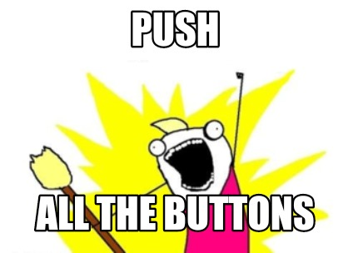
Using Our New Remote Control
remoteControl.setCommand(0, livingRoomLightOn,
livingRoomLightOff);
remoteControl.setCommand(1, kitchenLightOn,
kitchenLightOff);
remoteControl.setCommand(2, secArm, secDisarm);
remoteControl.setCommand(3, stereoOnWithCD, stereoOff);
remoteControl.onButtonPushed(0);
remoteControl.offButtonPushed(0);
remoteControl.onButtonPushed(1);
remoteControl.offButtonPushed(1);
remoteControl.onButtonPushed(2);
remoteControl.offButtonPushed(2);
remoteControl.onButtonPushed(3);
remoteControl.offButtonPushed(3);
Notes:
Next, we program our remote control. We || set slot 0 to control the living room light, slot 1 for the kitchen light, slot 2 for the security control, and slot 3 for the stereo. In this case, we set the on button for the stereo to turn it on with the mode set to CD, but we can always reprogram it to another mode.
Let’s || push all the buttons! We are going to go from top to bottom, pushing the on and off buttons for slot 0, 1, 2 and 3 in sequence. Let’s see what happens.

Slide 28
Using Our New Remote Control
Output:
Living Room Light is ON.
Living Room Light is OFF.
Kitchen Light is ON.
Kitchen Light is OFF.
Security system is ARMED.
Security system is DISARMED.
Stereo is ON.
Stereo Mode set to CD.
Stereo volume set to 11.
Stereo is OFF.
Notes:
If everything is coded correctly, this should happen. Slot 0 controls the living room light, and so it will turn on and off. Then slot 1 will turn the kitchen light on and off. Slot 2 controls the security system, which will first be armed, then disarmed. Finally, slot 3 controls the stereo. We see that when the on button for slot 3 is pushed, it will turn the stereo on, then set the mode to CD, then set the volume to 11. Finally, the off button will turn off the stereo. Success!

Slide 29
What About Undo?
Give every Command an undo() method
public interface Command {
public void execute();
public void undo();
}
Notes:
Right, we’ve waited long enough. How do we implement the undo function? It’s actually not that difficult. For every command, we need to know what to do when we want to undo that command, so we are going to || add the undo() method to the Command interface. This means that all commands must implement their own undo() method.

Slide 30
undo() method
public class LightOnCommand: Command {
Light light;
public LightOnCommand(Light light) {
this.light = light;
}
public void execute() {
light.on();
}
public void undo() {
light.off();
}
}
Notes:
Then we go to each command class to code their undo() method. For example, here is the updated LightOnCommand class. To undo() the light on command, we || turn the light off. Easy.

Slide 31
Updating the Remote Control
public class RemoteControl {
Command[] onCommands;
Command[] offCommands;
Command undoCommand;
public RemoteControl() {
onCommands = new Command[7];
offCommands = new Command[7];
Command noCommand = new NoCommand();
for (int i = 0; i < 7; i++) {
onCommands[i] = noCommand;
offCommands[i] = noCommand;
}
undoCommand = noCommand;
}
Notes:
Other than that, we also need to keep track of the last command that was executed. For that, we need to make some minor modifications to our RemoteControl class. We will need an || attribute of type Command that we call undoCommand that stores the last command executed. In our constructor, we || initialize undoCommand to be noCommand since no commands have been executed yet.

Slide 32
Implementing the Remote Control
public void setCommand(int slot,
Command onCommand, Command offCommand) {
onCommands[slot] = onCommand;
offCommands[slot] = offCommand;
}
public void onButtonPushed(int slot) {
onCommands[slot].execute();
undoCommand = onCommands[slot];
}
public void offButtonPushed(int slot){
offCommands[slot].execute();
undoCommand = offCommands[slot];
}
Notes:
Then, for each of our button pushed methods, along with executing the corresponding command, we also || store it in the undoCommand attribute. This way, when the undo button is pushed, we know which command to undo.

Slide 33
Implementing the Remote Control
public void undoButtonPushed() {
undoCommand.undo();
}
}
Notes:
Finally, we add a method for the pushing of the undo button. What happens when you push undo? You guessed it – we call the undo() method of undoCommand. That’s all there is to it.

Slide 34
Testing the Undo Button
remoteControl.onButtonPushed(0);
remoteControl.undoButtonPushed();
remoteControl.onButtonPushed(0);
remoteControl.offButtonPushed(0);
remoteControl.undoButtonPushed();
Living Room Light is ON.
Living Room Light is OFF.
Living Room Light is ON.
Living Room Light is OFF.
Living Room Light is ON.
Notes:
Now let’s test the undo function. If we run this code, we should get || this output. So we first push the on button in slot 0, which will || turn the living room light on. This will store the LightOnCommand object into our undoCommand attribute, so when we next push the || undo button, it will call the undo() method of LightOnCommand, which turns the light back on. Next, let’s turn the light || on and off again. Finally, we push the undo button, and since the last command was a LightOffCommand, this will || turn the light back on.

Slide 35
More Complex Undo Functions
Store the previous state
E.g., for a command that sets the speed of a fan, store the previous speed value
Multiple undo actions
Keep the commands in a stack
For each command, push it onto the stack
For each undo, pop it from the stack
Notes:
So that was the basics of how we implement the undo function. Of course, what I showed you was very straightforward since the opposite of on is off, and vice versa. But you may some actions that are harder to undo. For example, if your last action was to set the speed of a fan, then undoing the action will require setting the speed to the previous setting. This means that we also have to store the previous speed setting. In general, for such commands, we want to || store the previous state so that undo can properly reverse the action.
For those of you who regularly use CTRL-Z to undo a bunch of actions, I’m sure you’re || wondering how you can achieve that. Conceptually, this means that we can’t just store one previous action, we have to store a history of actions, and we should do it in a || stack. Then each time we execute an action, we || push it onto the stack, and whenever we undo an action, we || pop it from the stack. This is exactly the kind of last-in-first-out process that a stack is meant to support.

Slide 36
What Have We Achieved?
Invokers are decoupled from Receivers
The class that calls the operation is independent from the objects being affected
Easy to add new Commands as existing classes are not affected
Commands can be manipulated and extended like any other object
Notes:
So that’s the Command design pattern. What have we achieved? Well, we have || decoupled the class that invokes the operation from the ones that knows how to perform it. This means that an Invoker can be configured to call the methods of any Receiver object without knowing the internal details of them. This decoupling also means that || adding new commands will not affect existing classes.
Also, Commands can be treated like any other object, so they can be extended with subclasses. If you want to build more complex commands based on simpler commands, you can do so.

Slide 37
Macro Commands
We can have commands made of multiple commands
public class MacroCommand: Command {
Command[] commands;
public MacroCommand(Command[] commands)
{
this.commands = commands;
}
Notes:
Another benefit of the Command pattern is the ability to make what is known as macro commands, which are commands composed of multiple commands. For example, suppose we want to program our remote control with a party mode where, with one push of a button, it will turn on the living room and kitchen lights, turn on the stereo and disarm the security system. How would we do this? Well, we can create a special kind of Command called a MacroCommand. This is still a command, so it || implements the Command interface. And since this command is made of multiple commands, we will use || an array to store this sequence of commands, which we will initialize in the constructor.

Slide 38
Macro Commands
public void execute() {
foreach (Command command in commands) {
command.execute();
}
}
public void undo() {
foreach (Command command in commands) {
command.undo();
}
}
}
Notes:
Then, whenever we execute this macro command, we will || traverse our array of commands and call each of their execute() methods. Same with undo().

Slide 39
Using Macro Commands
Command[] partyOn = { livingRoomLightOn, kitchenLightOn, stereoOnWithCD, secDisarm };
Command[] partyOff = { livingRoomLightOff, kitchenLightOff, stereoOff, secArm };
MacroCommand partyOnMacro = new MacroCommand(partyOn);
MacroCommand partyOffMacro = new MacroCommand(partyOff);
remoteControl.setCommand(4, partyOnMacro,
partyOffMacro);
Notes:
And now we can do some fancy stuff. Let’s create an array of Commands called || partyOn, consists of commands that turn the living room light on, the kitchen light on, the stereo on with the CD setting, and disarms the security system. partyOff is another array of Commands that does the reverse. With these arrays, we can use them to create our MacroCommand objects. For example, the MacroCommand called || partyOnMacro will take partyOn as its argument in the constructor, and same with partyOffMacro. Finally, let’s || set slot 4 of our remote control with these two macro commands.

Slide 40
Let’s Test It
remoteControl.onButtonPushed(4);
remoteControl.offButtonPushed(4);
remoteControl.undoButtonPushed();
Living Room Light is ON.
Kitchen Light is ON.
Stereo is ON.
Stereo Mode set to CD.
Stereo volume is set to 11.
Security system is DISARMED.
Living Room Light is OFF.
Kitchen Light is OFF.
Stereo is OFF.
Security system is ARMED.
Living Room Light is ON.
Kitchen Light is ON.
Stereo is ON.
Security system is DISARMED.
Notes:
Now we test our cool new macro commands as follows. We first push the on button, then the off button, then the undo button, and we should get || this output. As you can see, when the on button is pushed, || 4 commands are executed: the living room and kitchen lights are turned on, the stereo is turned on to CD mode and volume set to 11, and the security system is disarmed. When the off button is pushed, || 4 commands are also executed that turns the lights and stereo off and arms the security system. Finally, when we push the undo button, it will call the undo() methods of the previous command, which will || reverse the actions of all 4 commands. Now you can do really powerful and complicated things by combining different commands into a single macro command class. That’s just awesome.

Slide 41
Some Other Uses for Command
Queueing requests
E.g., job queues, schedulers
Action logs for recovery
Add store() and load() methods to Command
store() saves a command to disk
load() retrieves the stored command from disk
When recovering from a crash, the system will load and execute the stored commands
Notes:
So we know that the Command pattern is applicable when you want to parameterize or customize objects by an action that they want to perform, and this can be changed during run-time. It turns out that there are some applications where the Command pattern is a natural fit. We often have || requests that are queued, such as a job queue or scheduler. In those cases, we would be executing the first command in the queue, and proceed to the next command only after the first one is done. For such applications, the Command pattern is useful because Command objects have a lifetime independent of the original request, so even if, say, you submit a print request to a printer and log out before it is completed, the print request still exists and the printer can print your job anyway.
Another very common use for the Command pattern is recovery logs. For systems where you want to gracefully recover from a system crash, a standard technique is to use the Command pattern and add a store() and a load() method to the Command interface. store() is called whenever the command is executed, and it stores the state information to some external storage like a hard disk. Then if the system crashes maybe in the middle of executing a complicated command, we can use load() to retrieve the last commands from disk and re-execute them properly.

Slide 42
Summary
The Command design pattern
Notes:
So that was the Command design pattern, which encapsulates requests into separate objects. Even though these requests affect Receiver objects, the Invoker object that makes these requests are pretty much completely decoupled from them, so we can modify each object independently without affecting each other. As a bonus, the Command pattern also allows us to gracefully handle undo operations. Incidentally, the first time I saw a universal remote control, I thought to myself, “well, this changes everything.” Byee!

